Slide 1

C Practice 7
Notes:
Click to add notes

Slide 2
C Programming Practice Question 1
Modify Blink sketch from Arduino IDE: File | Examples | 01.Basics with a function called blink to determines how many times the LED will flash.
Hint:
void blink(int count) where count paramemter will decide the number of times LED will blink
Notes:
Lesson descriptions should be brief.

Slide 3
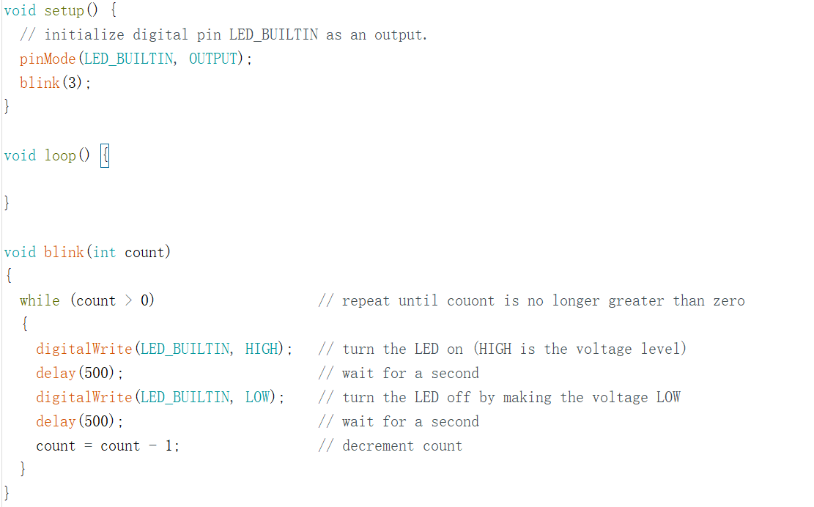
Answer
Notes:
Lesson descriptions should be brief.

Slide 4
Question 2
Write a program to randomly generate two integers and implement a function called swap() to swap the values by using global variables. Print out the values of the variables before swapping and after swapping.
Example: The value of x and y before swapping are: 7,3. The value of x and y after swapping are: 3,7

Slide 5
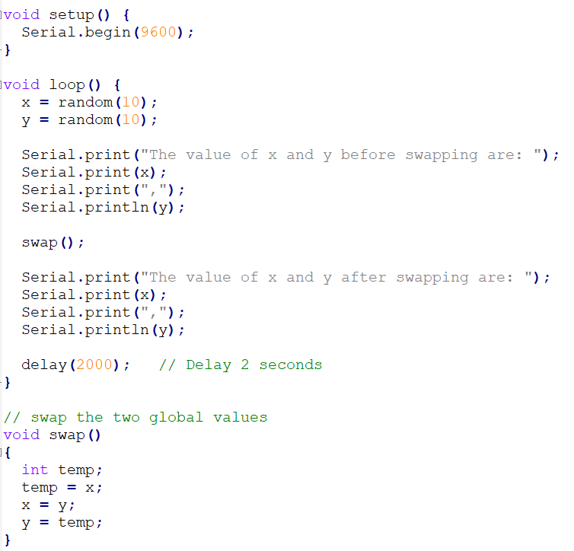
Answer
Notes:
Lesson descriptions should be brief.

